Slide 1
TEXTILE SHOP MANAGEMENT SYSTEM
S . Muthamilselvi
III - Bsc computer science
L.R.G Government arts college for women
GUIDE NAME : Dr.A.Finny Belwin, MCA., M.Sc., Ph.D

Slide 2
AGENDA
Abstract
Objective
Hardware specification
Software specification
Existing system
Proposed system
Modules
Data flow diagram
Table
Form design
Conclusion

Slide 3
ABSTRACT
The Textile management system application is developed for managing the textile shop.
The idea of textile shop development is how to manage the textile shop in a good manner .
How the things is proper in the shopping mall, what is the input in the shopping mall and what is the output how to track the goods are available there or which is sort.
All this is auto track by the application from which there will be no any difficulties facing by the management after all there are certain report generation based on the shopping mall daily turnover, monthly turnover etc .

Slide 4
OBJECTIVE:
The main goal of this project is to reduce manual works, increase the processing speed and ensure reliability of data.
All process needed for the textile management is recorded for providing good information to the concern.
Various reports are generated based on the requirement.
Reports will present the management with the current position of the company.

Slide 5
Hardware Specification
PROCESSOR : Intel core13
RAM : 4 GB RAM
Hard Disk Drive : 500 GB
Keyboard : Optical
Mouse : Optical

Slide 6
Software Specification
Operating System :Windows7
Front End :Java
Database :Mysql

Slide 7
EXISTING SYSTEM
The existing system the users very hard to maintain the textile shop.
We can’t know about the textile dress or material details manually.
Sometimes it makes confusing to find the dress rates it may cause big issue.

Slide 8
Disadvantages:
Very hard to find the cost of dress.
All works are manually implemented.
Man power works too hard.

Slide 9
PROPOSED SYSTEM
The purpose of the project is to develop a ‘Textile management system’, which will be used by the company through which all purchase details of textile can be managed by the company.
The system deals with very popular interface tool retrieval of the record is which faster than the present system.
Hence it cause to saving time for the further work.

Slide 10
Advantages:
Searching features is quite faster .
Attractive user interface.
Billing details very easy to handle.

Slide 11
Modules
Admin Module
Customer Module
Purchase module
Sales module
Billing module
Stock module

Slide 12
MODULES
Admin module
Managing the whole work of our textile.
He is responsible person for maintaining the customer details, purchase order details, sales and billing.
Customer module
A Customer module is used to store the customer’s details in this module. We can search the customer details immediately.
We can manage the history of customer’s details which is helpful to find our regular customer.

Slide 13
Purchase module
This modules contains are user purchase the item details maintained.
It includes are item name, purchasing date, no of quantity, rate details and so on.
Sales module
This module has been used when the manager submit the billing after collecting the money.
This module helps to calculate the stock and billing details.
This module has contain dress and customer details.

Slide 14
Billing module
Billing module is an output of our application also it’s a main module. This will generate the date wise bill details.
Also it will show the customer details who is purchasing and how much they were purchasing.
Stock module
Stock module has details of available stock. With item, batch price and quantity details.
It also has details of sold stock details. Using this details we can put more purchase order if we want.

Slide 15
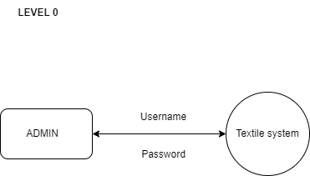
Data Flow Diagram

Slide 16
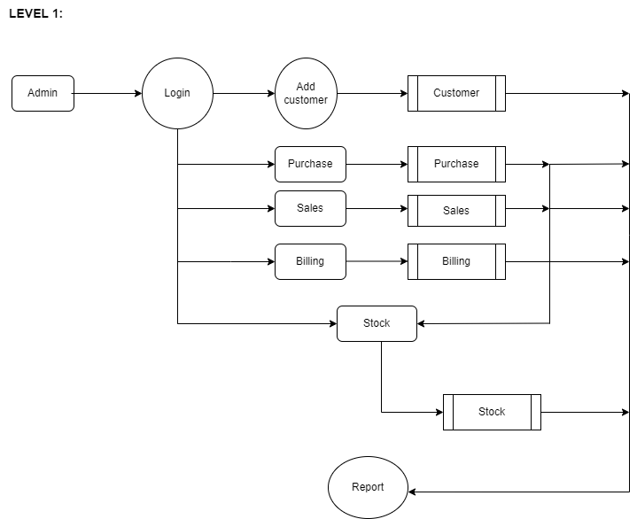

Slide 17
TABLE NAME: ADMIN
FIELD | DATA TYPE | SIZE | CONSTAINT
Admin Id | Int | 10 | Primary key
User name | Varchar | 20 | Not null
Password | Varchar | 20 | Not null

Slide 18
TABLE NAME: CUSTOMER
FIELD | DATA TYPE | SIZE | CONSTAINT
Customer id | Int | 10 | Primary key
Company name | Varchar | 20 | Not null
Mobile number | Int | 10 | Not null
Address | Varchar | 30 | Not null
Pin code | Int | 6 | Not null

Slide 19
TABLE NAME: PRODUCT
FIELD | DATA TYPE | SIZE | CONSTAINT
Product id | Int | 10 | Primary key
Company name | Varchar | 20 | Not null
Brand | Varchar | 20 | Not null
Product name | Varchar | 20 | Not null
Price | Int | 7 | Not null

Slide 20
TABLE NAME: PURCHASE
FIELD | DATA TYPE | SIZE | CONSTRAINT
Purchase id | Int | 10 | Primary key
Product name | Varchar | 20 | Not null
Quantity | Int | 10 | Not null
Company name | Varchar | 20 | Not null
Brand | Varchar | 20 | Not null
Price | Int | 7 | Not null

Slide 21
TABLE NAME: SALES
FIELD | DATA TYPE | SIZE | CONSTRAINT
Sales id | Int | 10 | Primary key
Customer id | Int | 10 | Foreign key
Mobile number | Int | 10 | Not null
Customer name | Varchar | 20 | Not null
Address | Varchar | 20 | Not null
Pin code | Int | 6 | Not null
Product name | Varchar | 20 | Not null
Quantity | Int | 10 | Not null
Company name | Varchar | 20 | Not null
Brand | Varchar | 20 | Not null
Price | Int | 7 | Not null
Total amount | Int | 7 | Not null

Slide 22
TABLE NAME: BILLING
FIELD | DATA TYPE | SIZE | CONSTRAINT
Date | Date/time | DD/MM/YY | Not null
Customer name | varchar | 20 | Not null
Company name | varchar | 20 | Not null
Brand | Varchar | 20 | Not null
Product name | Varchar | 20 | Not null
Price | Int | 7 | Not null
Quantity | Int | 10 | Not null
Total amount | Int | 7 | Not null
Billing id | Int | 30 | Not null

Slide 23
TABLE NAME: STOCK
FIELD | DATA TYPE | SIZE | CONSTRAINT
Stock id | Int | 10 | Foreign key
Company name | varchar | 20 | Not null
Brand name | varchar | 10 | Not null
Price | Int | 7 | Not null
Stock | Int | 20 | Not null

Slide 24
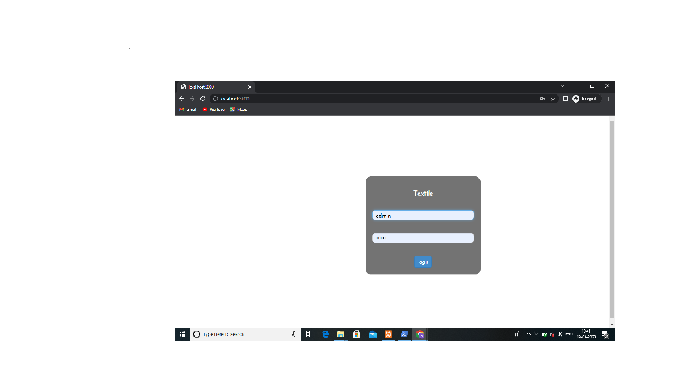
FORM DESIGN
ADMIN REGISTRATION :

Slide 25
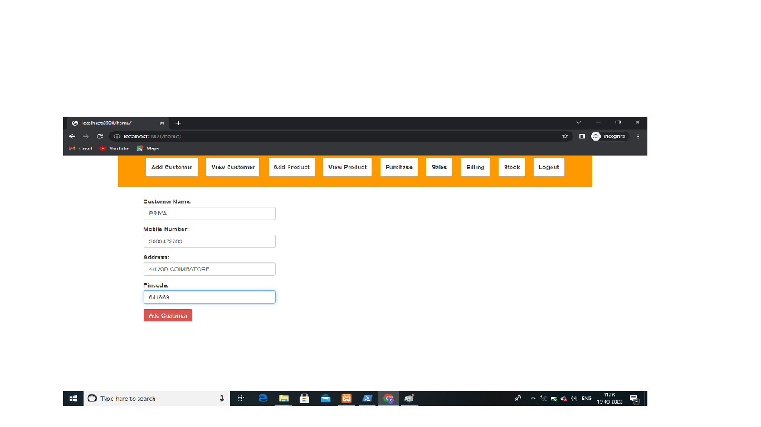
ADD CUSTOMER:

Slide 26
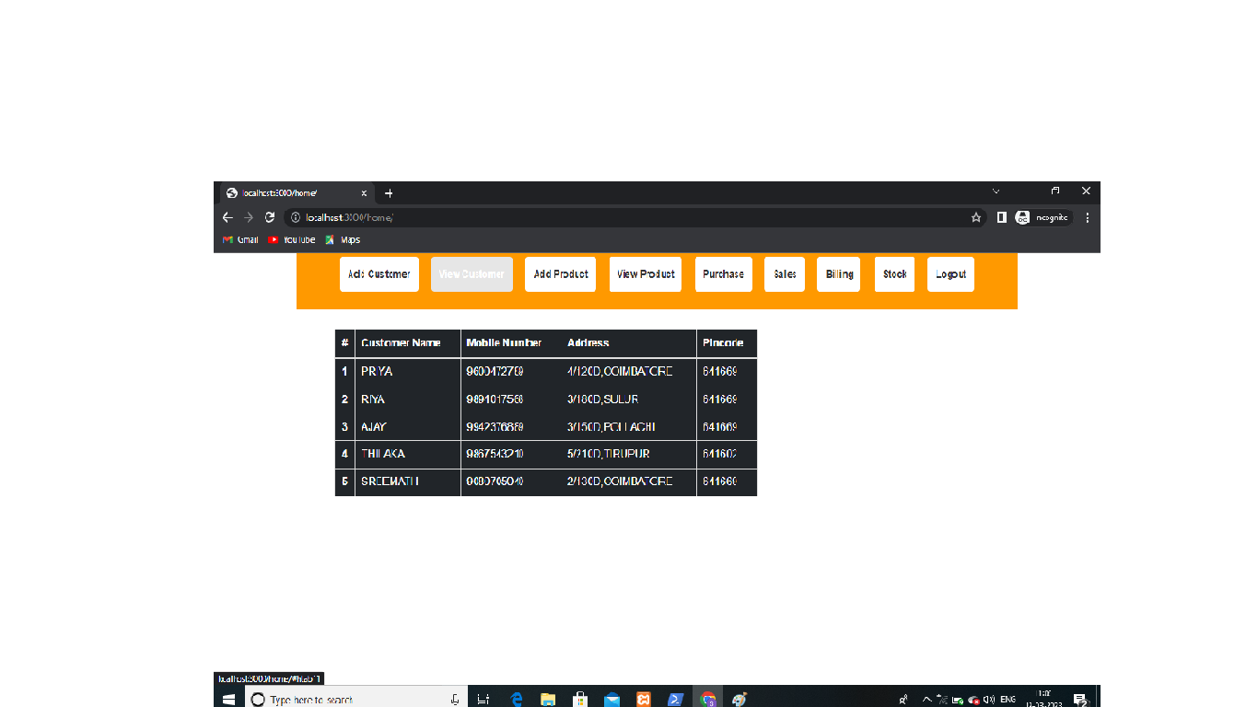
VIEW CUSTOMER:

Slide 27
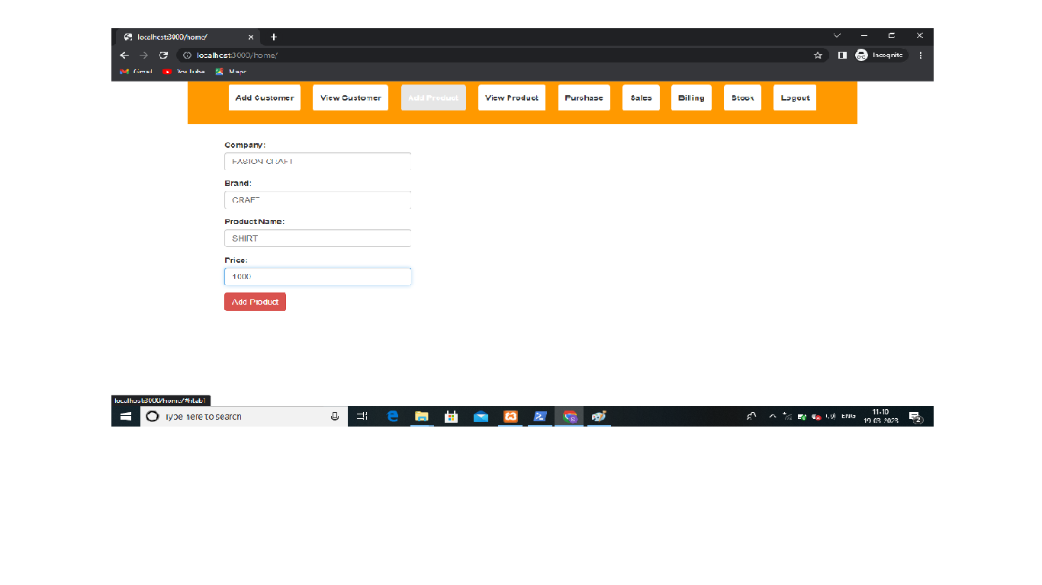
ADD PRODUCT:

Slide 28
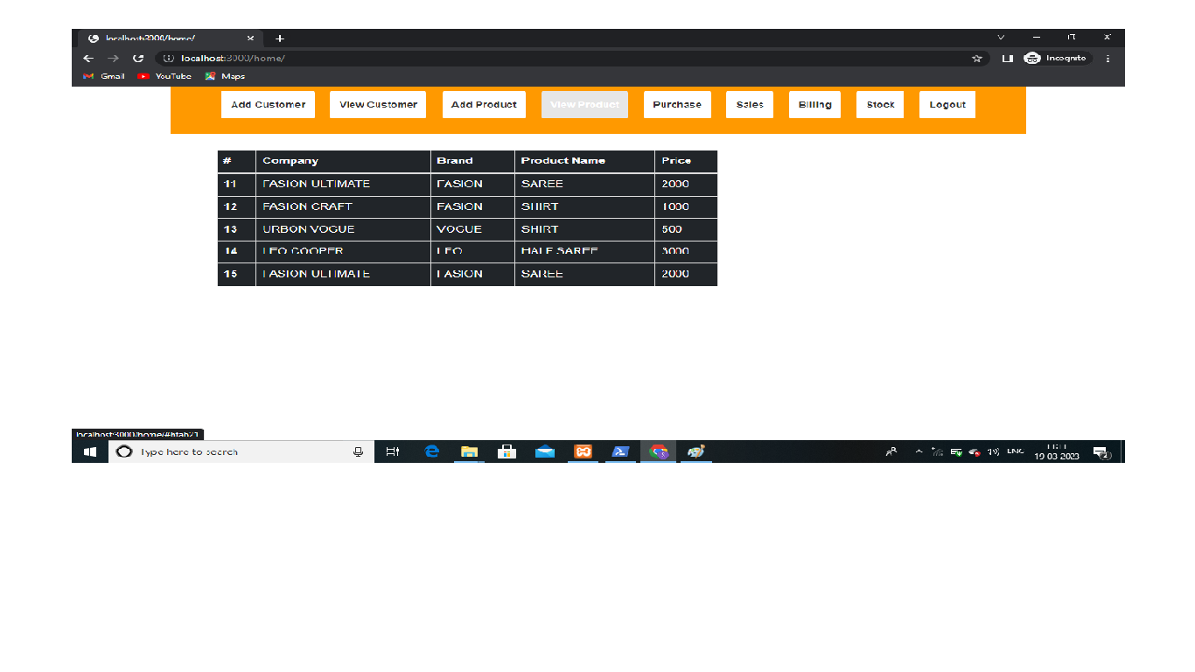
VIEW PRODUCT:

Slide 29
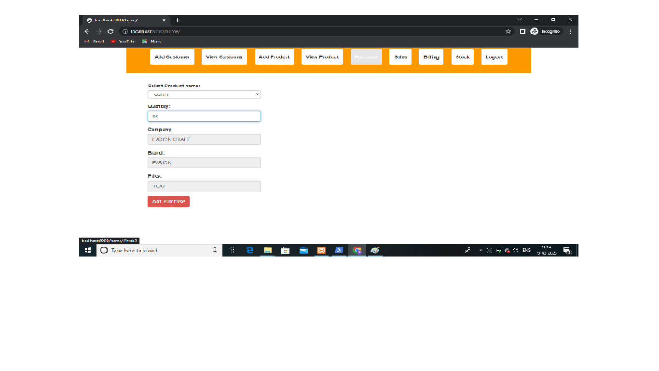
PURCHASE:

Slide 30
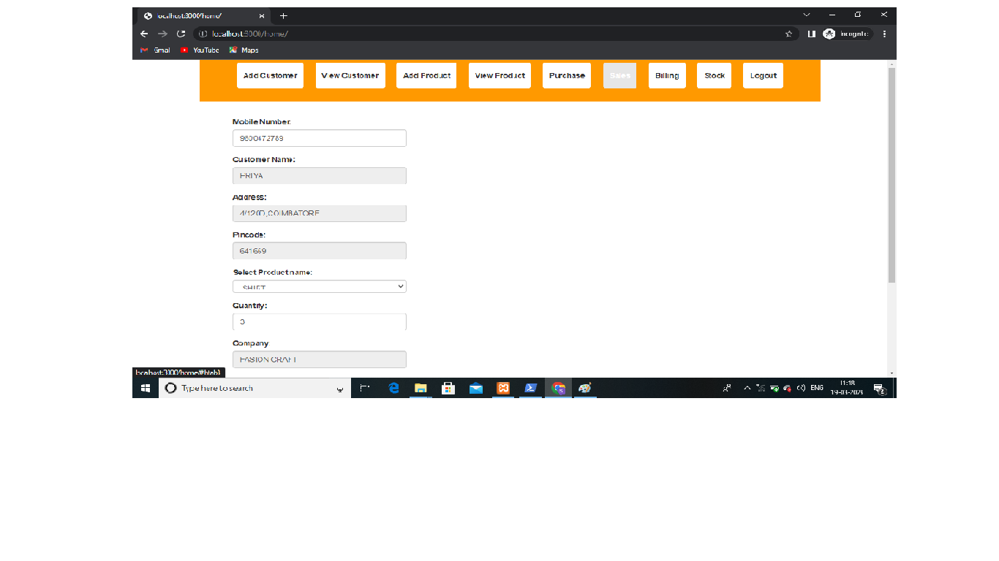
SALES:

Slide 31
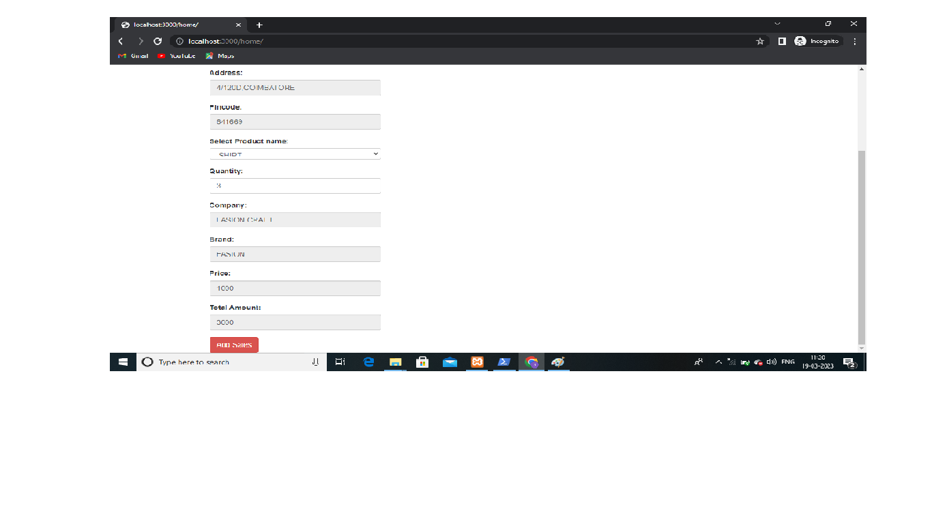

Slide 32
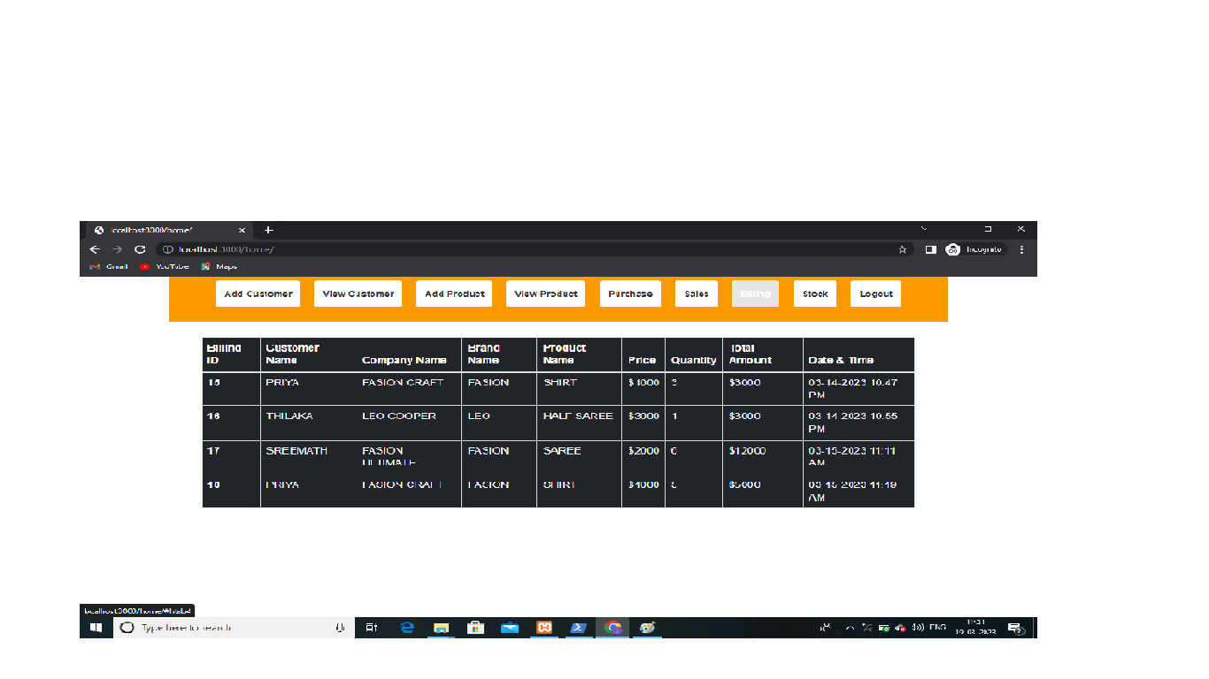
BILLING:

Slide 33
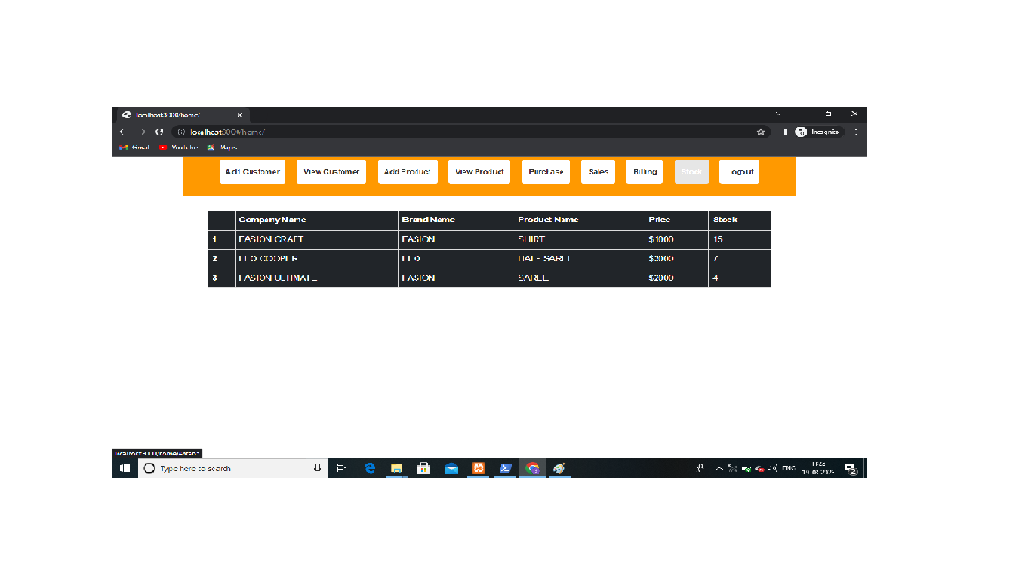
STOCK:

Slide 34
CONCLUSION
Textile Management Systems (TMS) are essential tools for managing and optimizing the production, distribution, and sales of textiles.
These systems provide several benefits, including improved efficiency, increased visibility, and reduced costs.
TMS ensures improved efficiency by enabling textile managers to streamline processes, optimize inventory levels, and reduce lead times.
This helps to improve the overall productivity of textile operations, reduce manufacturing and distribution costs, and enhance customer satisfaction.

Slide 35
Moreover, TMS provides increased visibility by providing real-time information on the status of orders, inventory levels, and production schedules.
This helps to improve decision-making, enhance transparency, and improve customer service.
TMS also reduces costs by optimizing resource allocation, reducing waste, and minimizing stockouts.
This leads to improved financial sustainability and the ability to invest in better infrastructure and services.

Slide 36
Thank you.....

